Slide 1
932
932
Q
Can we adopt CSMA/CD (used in wired Ethernet) for use in wireless networks
MAC for wireless networks
Notes:
The answer is no (and will be clarified next).

Slide 2
Side notes: Network aspects
MTP and SCCP are part of SS7, which is a set of protocols designed to provide control signaling within the network.
Notes:
Signal connection control part.

Slide 3
1
The basis of 802.11 MAC
MACA [Phil Karn, 1990]
MACAW [Bhargavan et. al., 1994]
Although Old but Phenomenal

Slide 4
MACA
One of the oldest protocols for wireless LANs
Multiple Access with Collision Avoidance is the basis of IEEE 802.11
BASIC IDEA
Sender stimulates the receiver to output a short frame to inform the nearby stations of a communication session
It caters for the two station problems illustrated earlier

Slide 5
Working of MACA
‘A’ sends RTS frame to ‘B’
RTS frame is of 30 bytes containing the length of the data frame that will follow
‘B’ replies with a CTS that copies length information from RTS
‘A’ starts transmitting upon receiving the CTS
Any station that hears RTS remains silent till CTS comes back to ‘A’
Similarly any station that receives the CTS must remain silent till data packets are received by ‘B’

Slide 6
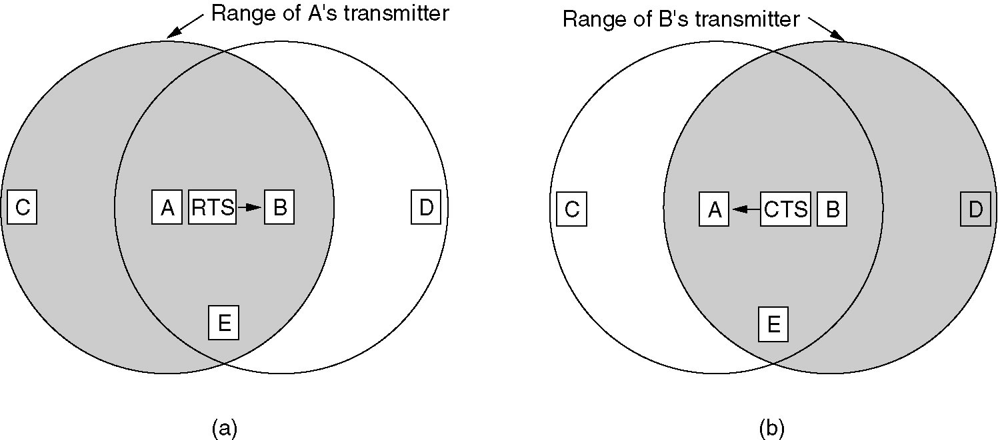
‘C’ for example, hears the RTS from ‘A’ but not the ‘CTS from ‘B’
Therefore it would not interfere with transmission from ‘A’
In the same manner, ‘D’ is within range of ‘B’ but not ‘A’
It does not hear the RTS but detects the CTS and defers its transmission till the data packets have been received by ‘B’

Slide 7
Problem Scenario
Despite the precautions, collisions can still occur
E.g., ‘B’ and ‘C’ both send RTS to ‘A’
Both the signaling packets shall collide and will be destroyed
Unsuccessful transmitters shall time out and transmit again after some random time
This is carried out by binary exponential back off algorithm

Slide 8
MACAW
MACA for Wireless
Following functionalities were added
Data link layer acknowledgements were added
CSMA was added to inhibit stations to transmit RTS simultaneously
Back off algorithm for source-destination pair instead of individual node

Slide 9
Multiple Access Collision Avoidance (MACA)
Proposed to overcome hidden/exposed node problems
A
B
AP
RTS(B)
RTS(A)
reservation collision
RTS(A)
CTS(A)
CTS(A)
DATA (A)
defer
time
Notes:
From: Medium Access Control protocols for ad hoc wireless networks: A survey (http://attila.sdsu.edu/~kumar/MAC_Survey.pdf)
The MACA protocol was proposed by Karn to overcome the hidden and exposed terminal problems in CSMA family of protocols [13]. MACA uses two short signaling packets, similar to the AppleTalk protocol [21]. If node A wishes to transmit to node B, it first sends an RTS packet to B, indicating the length of the data transmission that would later follow. If B receives this RTS packet, it returns a CTS packet to A that also contains the expected length of the data to be transmitted. When A receives the CTS, it immediately commences transmission of the actual data to B. The key idea of the MACA scheme is that any neighboring node that overhears an RTS packet has to defer its own transmissions until some time after the associated CTS packet would have finished, and that any node overhearing a CTS packet would defer for the length of the expected data transmission.
In a hidden terminal scenario, C will not hear the RTS sent by A, but it would hear the CTS sent by B. Accordingly, C will defer its transmission during A s data transmission. Similarly, in the exposed terminal situation, C would hear the RTS sent by B, but not the CTS sent by A. Therefore C will consider itself free to transmit during Bs transmission.
It is apparent that this RTS–CTS exchange enables nearby nodes to reduce the collisions at the receiver, not the sender. Collisions can still occur between different RTS packets, though. If two RTS packets collide for any reason, each sending node waits for a randomly chosen interval before trying again. This process continues until one of the RTS transmissions elicits the desired CTS from the receiver.
MACA is effective because RTS and CTS packets are significantly shorter than the actual data packets, and therefore collisions among them are less expensive compared to collisions among the longer data packets. However, the RTS–CTS approach does not always solve the hidden terminal problem completely, and collisions can occur when different nodes send the RTS and the CTS packets.
Another weakness of MACA is that it does not provide any acknowledgment of data transmissions at the data link layer. If a transmission fails for any reason, retransmission has to be initiated by the transport layer. This can cause significant delays in the transmission of data.

Slide 10
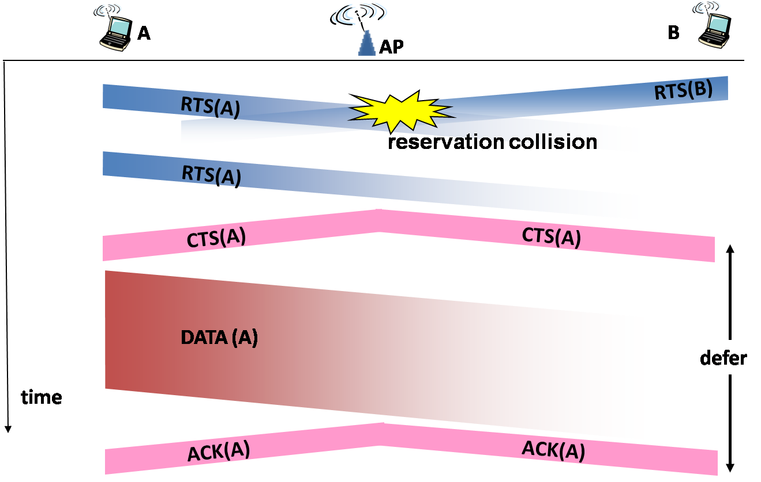
MACA for wireless networks (MACAW)
Notes:
From: Medium Access Control protocols for ad hoc wireless networks: A survey (http://attila.sdsu.edu/~kumar/MAC_Survey.pdf)
In order to overcome some of the weaknesses of MACA, Bharghavan et al. [14] proposed MACA for Wireless (MACAW) scheme that uses a five step RTS–CTS–DS–DATA–ACK exchange. MACAW allows much faster error recovery at the data link layer by using the acknowledgment packet (ACK) that is returned from the receiving node to the sending node as soon as data reception is completed. The backoff and fairness issues among active nodes were also investigated. MACAW achieves significantly higher throughput compared to MACA. It however does not fully solve the hidden and exposed terminal problems [15,20].

Slide 11
802.11 CSMA/ CA MAC
Physical carrier sensing
Virtual carrier sensing(through setting of NAV)
Notes:
From: Medium Access Control protocols for ad hoc wireless networks: A survey (http://attila.sdsu.edu/~kumar/MAC_Survey.pdf)
The IEEE 802.11 specifies two modes of MAC protocol: distributed coordination function (DCF) mode (for ad hoc networks) and point coordination function (PCF) mode (for centrally coordinated infrastructure-based networks) [22– 25]. The DCF in IEEE 802.11 is based on CSMA with Collision Avoidance (CSMA/CA), which can be seen as a combination of the CSMA and MACA schemes. The protocol uses the RTS–CTS–DATA–ACK sequence for data transmission.
Not only does the protocol use physical carrier sensing, it also introduces the novel concept of virtual carrier sensing. This is implemented in the form of a Network Allocation Vector (NAV), which is maintained by every node. The NAV contains a time value that represents the duration up to which the wireless medium is expected to be busy because of transmissions by other nodes.
Since every packet contains the duration information for the remainder of the message, every node overhearing a packet continuously updates its own NAV.
Time slots are divided into multiple frames and there are several types of inter frame spacing (IFS) slots. In increasing order of length, they are the Short IFS (SIFS), Point Coordination Function IFS (PIFS), DCF IFS (DIFS) and Extended IFS (EIFS). The node waits for the medium to be free for a combination of these different times before it actually transmits. Different types of packets can require the medium to be free for a different number or type of IFS. For instance, in ad hoc mode, if
the medium is free after a node has waited for DIFS, it can transmit a queued packet. Otherwise, if the medium is still busy, a backoff timer is initiated.
The initial backoff value of the timer is chosen randomly from between 0 and CW-1 where CW is the width of the contention window, in terms of time-slots. After an unsuccessful transmission attempt, another backoff is performed with a doubled size of CW as decided by binary exponential backoff (BEB) algorithm. Each time the medium is idle after DIFS, the timer is decremented. When the timer expires, the packet is transmitted. After each successful transmission, another random backoff (known as post-backoff) is performed by the transmission-completing node.
A control packet such as RTS, CTS or ACK is transmitted after the medium has been free for SIFS. IEEE 802.11 DCF is a widely used protocol for wireless LANs.

Slide 12
Key characteristics of
802.11 CSMA/ CA MAC
2

Slide 13
CSMA - CA
Physical
as well as
Virtual
Carrier Sensing
Notes:
802.11 addresses these two problems with an algorithm called Multiple Access with Collision Avoidance (MACA). The idea is for the sender and receiver to exchange control frames with each other before the sender actually transmits any data. This exchange informs all nearby nodes that a transmission is about to begin. Specifically, the sender transmits a Request to Send (RTS) frame to the receiver; the RTS frame includes a field that indicates how long the sender wants to hold the medium (i.e., it specifies the length of the data frame to be transmitted). The receiver then replies with a Clear to Send (CTS) frame; this frame echoes this length field back to the sender. Any node that sees the CTS frame knows that it is close to the receiver, and therefore cannot transmit for the period of time it takes to send a frame of the specified length. Any node that sees the RTS frame but not the CTS frame is not close enough to the receiver to interfere with it, and so is free to transmit.
There are two more details to complete the picture. First, the receiver sends an ACK to the sender after successfully receiving a frame. All nodes must wait for this ACK before trying to transmit. Second, should two or more nodes detect an idle link and try to transmit an RTS frame at the same time, their RTS frames will collide with each other. 802.11 does not support collision detection, but instead the senders realize the collision has happened when they do not receive the CTS frame after a period of time, in which case they each wait a random amount of time before trying again. The amount of time a given node delays is defined by the same exponential backoff algorithm used on the Ethernet (see Section 2.6.2 of your textbook).
The design of MACA design is based on four key observations. [Bhargavan94: http://pdos.lcs.mit.edu/decouto/papers/bharghavan94.pdf]
Firstly, the relevant contention is at the receiver, not the sender. This renders the carrier sense approach inappropriate. Second, congestion is location dependent; in fact, the first observation is irrelevant without the second. Third, to allocate media access fairly, learning about congestion levels must be a collective enterprise. That is, the media access protocol should propagate congestion information explicitly rather than having each device learn about congestion independently. Fourth, the media access protocol should propagate synchronization information about contention periods, so that all devices can contend effectively.

Slide 14
CSMA - CA
1
Physical Carrier Sensing
(listen before transmit)

Slide 15
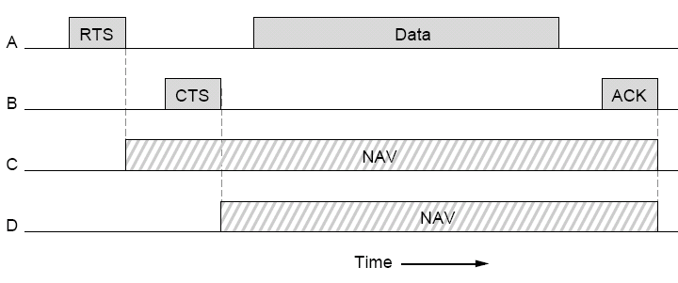
CSMA - CA
2
Virtual Carrier Sensing
(a-priori knowledge of other’s transmissions)

Slide 16
CSMA - CA
Collision Avoidance

Slide 17
CSMA - CA
1
Physical
as well as
Virtual
Carrier Sensing

Slide 18
CSMA - CA
2
Conservative approach
to transmit over idle medium
Exponential backoff
1) on sensing medium busy
2) on not receiving acknowledgements

Slide 19
Conservative approach
to transmit over idle medium

Slide 20
The 802.11 MAC Layer
The 802.11 MAC layer simultaneously supports both multiple access and time division multiplexed access
Distributed Coordination Function (DCF):
Contention-based access: Multiple access using binary exponential backoff
Can optionally use RTS/CTS
Point Coordination Function (PCF): (optional)
Contention-free access: Time Division Multiplexing arbitrated by the access point (AP)
Long packets are fragmented at the MAC Layer
Positive ACKs are used for reliability

Slide 21
The 802.11 MAC Layer
Even when the medium is available, wireless nodes wait for fixed amount of time before transmitting
Three wait durations:
Short Interframe Space (SIFS)
DCF Interframe Space (DIFS)
PCF Interframe Space (PIFS)

Slide 22
The 802.11 MAC Layer
Contention window
Busy
Transmission
SIFS
PIFS
DIFS

Slide 23
The 802.11 MAC Layer: Distributed Coordination Function (DCF)
802.11 DCF is a distributed channel access mechanism
RTS/CTS is used optionally in DCF
DCF uses two types of carrier sensing
Physical carrier sensing
Virtual carrier sensing

Slide 24
The 802.11 MAC Layer: Distributed Coordination Function (DCF)
Virtual carrier sensing
In virtual carrier sensing, a transmitted frame informs all other nodes that they should defer their transmission
The amount of deferred time is called the Network Allocation Vector (NAV)
Notes:
The NAV can be thought of as a client's best guess as to how long the medium will be busy. The client's NAV is updated in response to receiving a frame whose duration field contains a value that exceeds the current NAV value.

Slide 25
The 802.11 MAC Layer: Distributed Coordination Function (DCF)
SIFS
SIFS
DIFS
SIFS
RTS
MAC Frame
Sender
CTS
ACK
Receiver
NAV (RTS)
NAV
NAV (CTS)
Drawing based on Figure 3.5, pg. 20, Mathew S. Gast, 2nd ed.

Slide 26
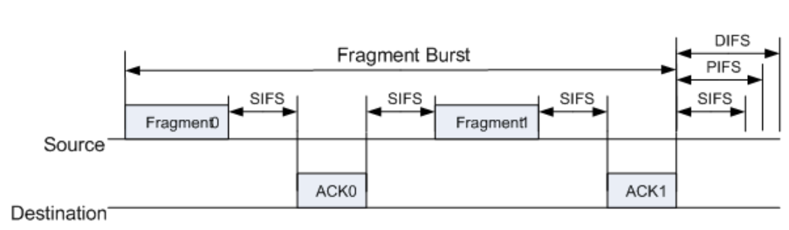
Fragmenting
packets

Slide 27
802.11 Mode of Operation
802.11 standards define PHY/ MAC for wireless LANs
1) Distributed Coordination Function (Distributed)
Distributed like Ethernet (but still different)
Appropriate for ad-hoc operation
802.11 standard mandates implementation of DCF
2) Point Coordination Function (Centralized)
Base station (AP) schedules/ controls all activities
Available for infrastructure based WLANs only
No collisions possible
Notes:
DCF like 802.3 or Ethernet’s CSMA/ CD is random-access and does not provide any timing guarantees. This does not lend itself to real-time or ‘fair’ communications over 802.11.
In situations, where we need fair or deterministic access to the medium, PCF can be used. However, PCF is only usable in Infrastructure based WLANs and is also commonly not implemented. The point-coordinator (on which PCF is based) is usually implemented on the AP and therefore is centralized.
The most common implementation of the 802.11 mode is of the DCF mode.
It is important to note here that PCF is contention free and DCF is contention-based.
PCF and DCF can co-exist as well when PCF is implemented.

Slide 28
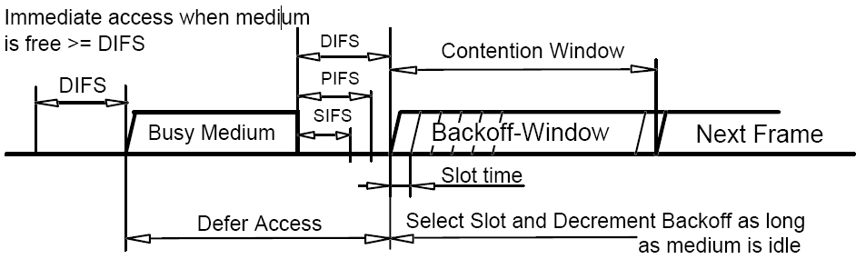
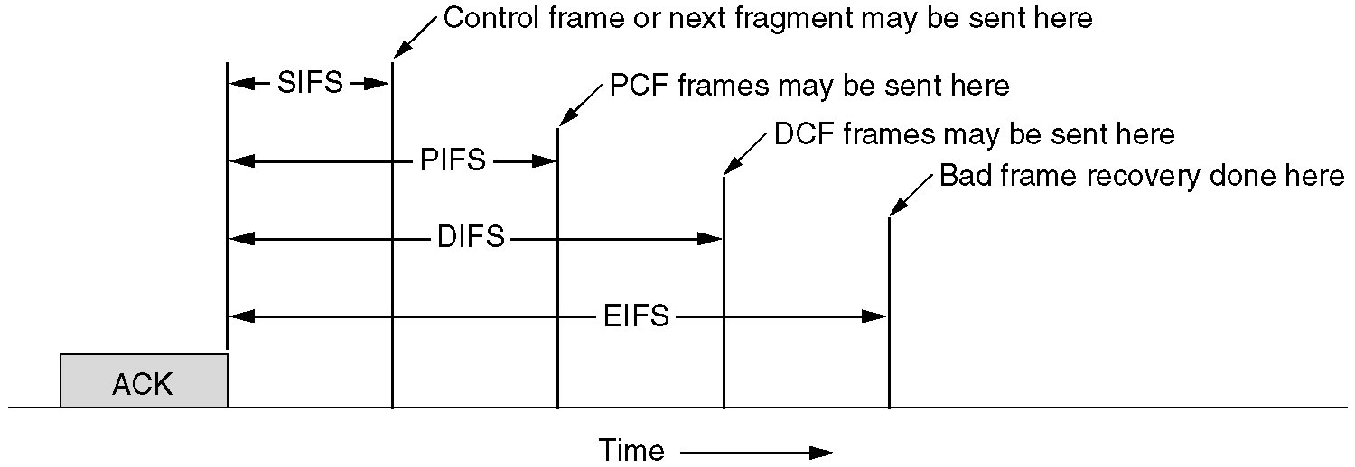
DCF operation
Notes:
http://ecomputernotes.com/computernetworkingnotes/multiple-access/carrier-sense-multiple-access-with-collision-avoidance

Slide 29
CSMA/ CA algorithm - Sender
If sense channel busy then
if back-off timer (BO timer) is zero
Random exponential back-off
wait for step 2
If channel is sensed idle for DIFS time
while (BO timer is non-zero)
decrement the BO timer every idle slot
freeze BO timer if channel becomes busy;
restart decrementing after link sensed to be idle for DIFS time.
transmit entire frame (no Collision Detection)
If no ACK received within a certain time
Increase random backoff interval, random backoff, repeat from step 2
BO timer is initially zero
sender
receiver
DIFS
data
SIFS
ACK
Notes:
If the station is still idle wait for a time equal to contention window…………AKA BO timer
If the station is ready to send, it chooses random number of slots as wait times
Wait times can be 2, 4, 6, 8, 16 ……..31

Slide 30
CSMA/ CA algorithm - Sender
Node has data to transmit
Random exponential back-off < contention window
If channel found busy at any time (pause BO timer)
After timer expires
Sense channel
If free (wait for a short time)
If still free (send RTS)
after receiving CTS from receiver
transmit entire frame (no Collision Detection)
If no ACK received within a certain time
Increase random back-off interval, random back-off, repeat
sender
receiver
DIFS
data
SIFS
ACK
Notes:
DCF (Distributed Co-ordination Function) is the MAC technique used by Wireless LANs (Infrastructure mode).
DIFS is an amount of interval, called the DCF Interframe Space, which a node waits before transmitting if the channel is found idle.
SIFS, also known as the Short Interframe Space, is the time a receiver will wait before sending an ACK.

Slide 31
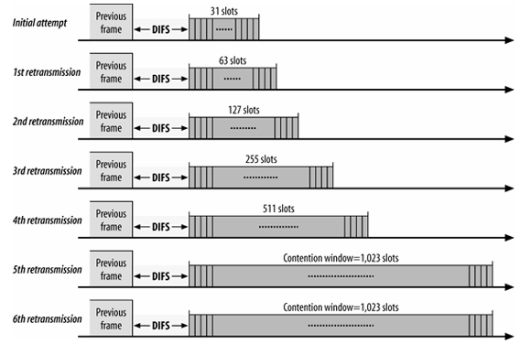
Contention windows for 802.11b
Contention window is an amount of time divided into slots.
• A station that is ready to send chooses a random number of slots as its wait time.
• The number of slots in the window changes according to the binary exponential back-off strategy.

Slide 32
CSMA/ CA algorithm - Receiver
sender
receiver
DIFS
data
SIFS
ACK
If frame received OK
Return ACK after an interval (after SIFS )
(ACK needed to ensure reliability)

Slide 33
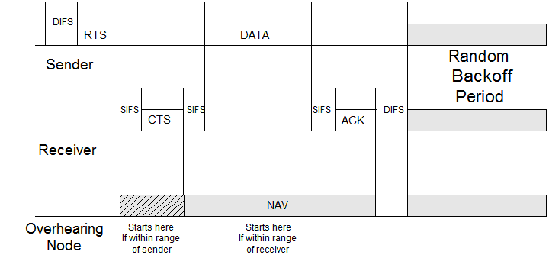
DCF timing operation example
What if contention window is too small? Too large?

Slide 34

The 802.11 MAC Layer: Generic Data Frame Format
An 802.2 logical link control header follows the MAC header
This header is used to encapsulate higher layer protocols
Image Courtesy of Mathew S. Gast, 2nd ed.
Notes:
IEEE 802.2 is the name given to a subsection of the IEEE 802 standard that describes a software component of a computer network. It defines Logical Link Control (LLC), which is the upper portion of the data link layer of the OSI Model. The LLC sublayer presents a uniform interface to the user of the data link service, usually the network layer. Beneath the LLC sublayer is the Media Access Control (MAC) sublayer, which is dependent on the particular medium being used

Slide 35
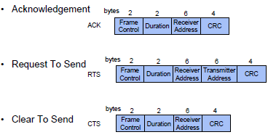
Special Frames: ACK, RTS, CTS

Slide 36
[ End of lecture ]

